Slide 1



Technical Facilities of Information
Prepared & Presented by: Mirlan Nurbekov, Lecturer
Office hours: Friday 9:00–17:00
AlaToo IT & Business College
Fall 2025

Slide 2
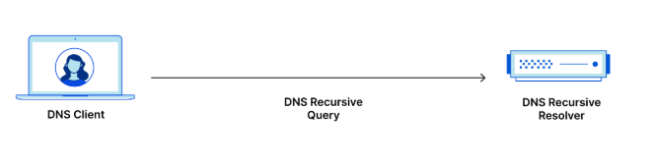
DNS in detail
When you type a website name like www.alatoo.edu.kg into your browser, computers don’t understand names, they need an address made of numbers. In this case, alatoo.edu.kg resolves to the IP address 212.42.101.253.

Slide 3

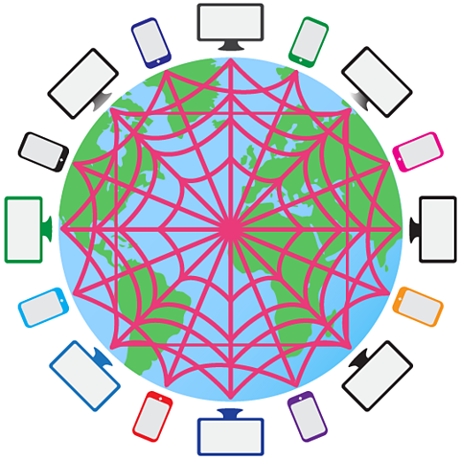
How does it work?

Slide 4

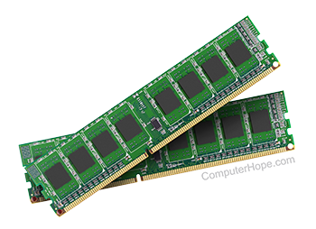
Stage 0000 - stub resolver
DNS client running on your machine to see your cashe, because you might have recently visited the place u were looking for.

Slide 5

Stage 0001 - common DNS server
Your stub resolver will send a DNS query to the Google DNS servers (public) it is basically a phonebook for the Internet. Preferred DNS server: 8.8.8.8

Slide 6
Stage 0002 - cashe
Google DNS servers will search through its cashe to see if this request was made before by other users and act accordingly, if no then next stage will start

Slide 7
Stage 0003 - recursive means
Google DNS servers are mainly recursive which means it connects to other servers to look for the requested information. (making multiple requests to other DNS servers to find)

Slide 8

Stage 0004 - 13 root servers

Slide 9
Stage 0004 - 13 root servers
When the DNS resolver cannot find the answer locally, it goes to the root servers. There are 13 logical root servers, named from A to M, and they are the highest level of the DNS hierarchy. These servers don’t store the IP of every website — instead, their job is to direct the DNS resolver to the correct Top-Level Domain (TLD) server, for example .kg, .com, .org.

Slide 10
Stage 0004 - 13 root servers
Although we say ‘13 servers,’ each one is actually a global network of hundreds of physical servers distributed across many countries. This makes the DNS system fast, reliable, and resistant to failure or attacks. So the root servers are like the first major checkpoint in the DNS lookup process, guiding the resolver to the correct TLD based on the domain extension.

Slide 11
Stage 0004 - 13 root servers
Name | Operator
a.root-servers.net | VeriSign Global Registry Services
b.root-servers.net | University of Southern California, Information Sciences Institute (USC-ISI)
c.root-servers.net | Cogent Communications
d.root-servers.net | University of Maryland
e.root-servers.net | NASA Ames Research Center

Slide 12
Stage 0004 - 13 root servers
Name | Operator
f.root-servers.net | Internet Systems Consortium, Inc. (ISC)
g.root-servers.net | US DoD Network Information Center
h.root-servers.net | US Army Research Lab
i.root-servers.net | Netnod
j.root-servers.net | VeriSign Global Registry Services

Slide 13
Stage 0004 - 13 root servers
Name | Operator
k.root-servers.net | RIPE NCC
l.root-servers.net | ICANN
m.root-servers.net | WIDE Project

Slide 14
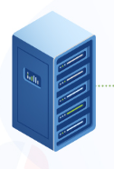
Stage 0005 -A TLD server
(Top-Level Domain)
Specific domain extension

Slide 15
DNS security problems:
DNS spoofing/cache poisoning
Attackers inject fake DNS records into a resolver cache
User is redirected to a fake or malicious website
Happens when DNS answers are not verified
Leads to phishing, credential theft, malware infections

Slide 16
DNS security problems:
DNS spoofing/cache poisoning
Cache poisoning is dangerous because users think they are visiting a real website, but the DNS sends them to an attacker’s IP address. All it takes is one fake entry in the resolver.

Slide 17
DNS security problems: DNS Hijacking
Attackers take control of DNS settings
Can be done by malware, router attack, or ISP interception
Redirects all user traffic to unwanted locations
Can block sites, spy on browsing, or show ads

Slide 18
DNS security problems: DNS Hijacking
In hijacking, the attacker doesn't poison the cache, they completely change where your DNS points. It’s like changing the phone book itself.

Slide 19
DNS security problems:
DDoS attacks on DNS servers
Attackers flood DNS servers with massive traffic
Legitimate queries cannot be processed
Causes slowdowns or complete outage of websites
Root servers and major DNS providers are frequent targets

Slide 20
DNS security problems:
DDoS attacks on DNS servers
A DNS server under DDoS attack becomes unavailable. Even though the website is fine, users cannot reach it because DNS resolution is blocked.

Slide 21
Self-test questions
1. What is the main purpose of DNS root servers?
2. Why does a stub resolver check its cache first?
3. What is the difference between DNS cache poisoning and DNS hijacking?
4. What role do TLD servers play in the DNS lookup process?
5. How can a DDoS attack affect DNS even if a website is working normally?

